Slide 1
Z3 Internals
Nikolaj Bjørner, Microsoft Research, RiSE
Clemens Eisenhofer, TU Wien
POPL tutorials, January 14, 2023

Slide 2
Overview
x
s

Slide 3
Material
z3 source on GitHub https://github.com/z3prover/z3
Online guide https://microsoft.github.io/z3guide
Tutorial document https://z3prover.github.io/papers/z3internals.html

Slide 4

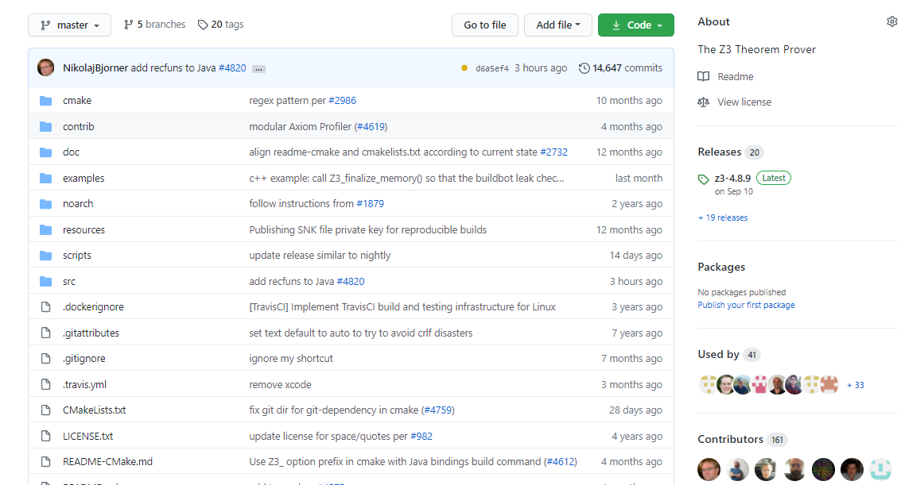
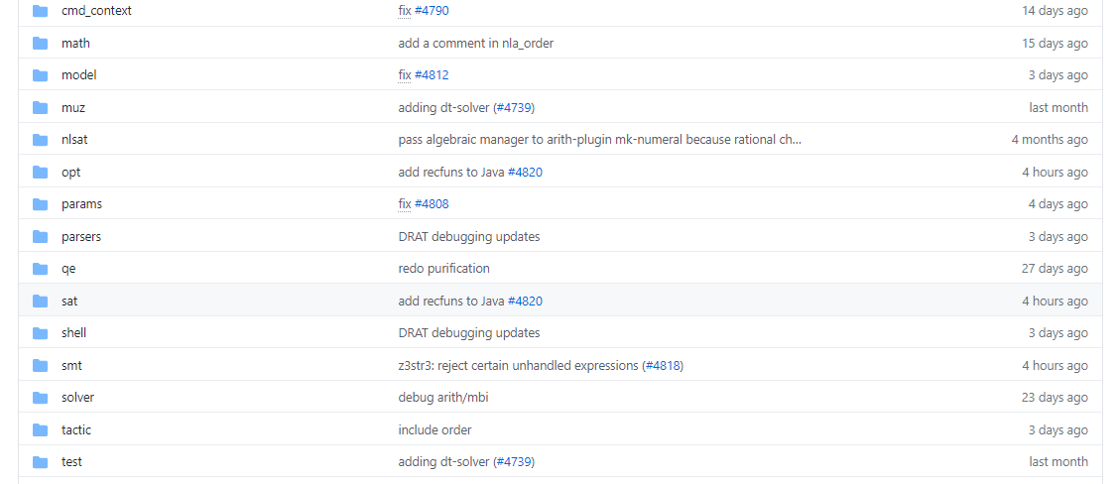
on GitHub
Scope of this tutorial

Slide 5
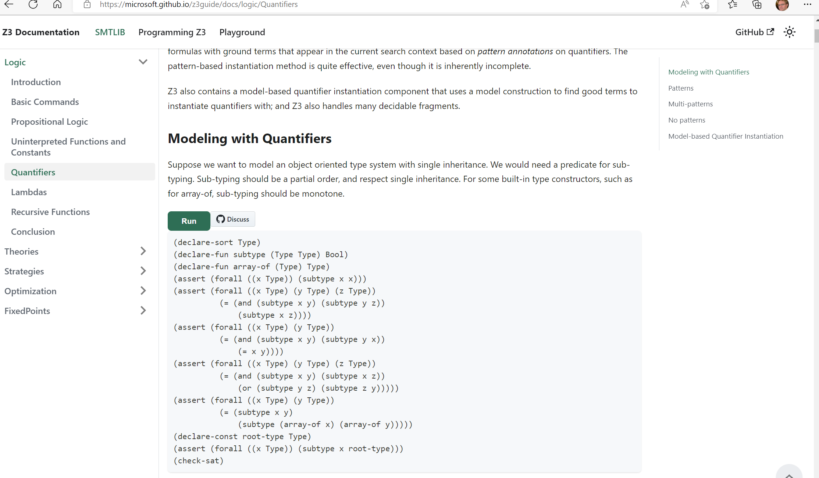
Online guide

Slide 6
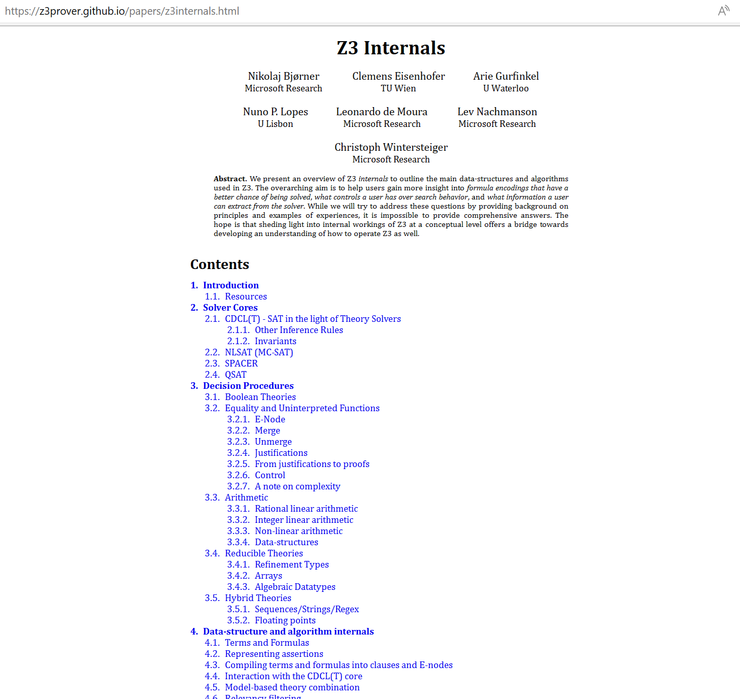
Tutorial document

Slide 7
What to expect when expecting a z3 internals tutorial?

Slide 8



What (some) users want to learn
How can I tune formulas to be solved by Z3?
What features of Z3 should I use for solving formulas?
Can I control the output of Z3
models (to be diverse, random)?
How can I have Z3 provide feedback on solving?
How can I determine which strategies apply to my formulas?

Slide 9
What a developer likes to talk about
Solvers
Algorithms
Data-structures
Logic features
Proof systems
Heuristics
Anatomy of Congruence Closure
How do solvers interact (with the core)?
How do solvers implement search?

Slide 10
Tutorial format
Understand Core Concepts
Understand where to dig further
Use cases shaped by anecdotes

Slide 11
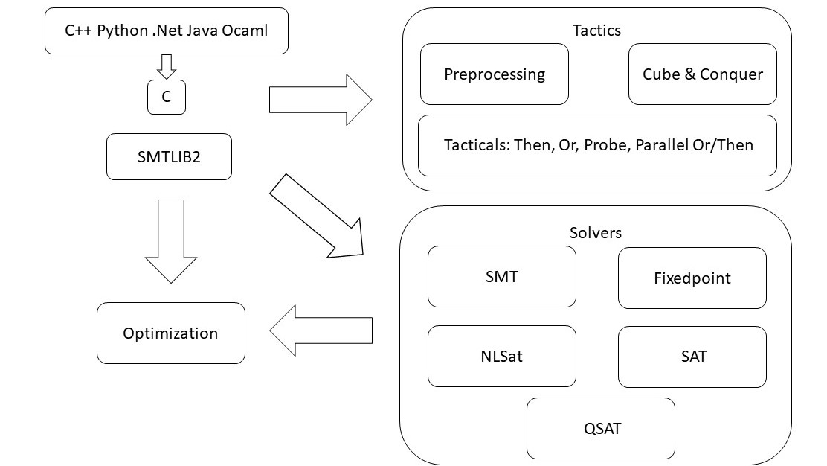
overview

Slide 12
Solver Engines
CDCL(T) SPACER NLSAT QSAT

Slide 13
overview

Slide 14

CDCL(T)
SAT
Theory
Solvers
SMT
Equality + UF
Arithmetic
Bit-vectors
…
Case Analysis

Slide 15
CDCL(T)
Basic Idea
x ≥ 0, y = x + 1, (y > 2 ∨ y < 1)
Abstract (aka “naming” atoms)
p₁, p₂, (p₃ ∨ p₄)
p₁ ≡ (x ≥ 0), p₂ ≡ (y = x + 1),
p₃ ≡ (y > 2), p₄ ≡ (y < 1)

Slide 16
CDCL(T)
Basic Idea
x ≥ 0, y = x + 1, (y > 2 ∨ y < 1)
Abstract (aka “naming” atoms)
p₁, p₂, (p₃ ∨ p₄)
p₁ ≡ (x ≥ 0), p₂ ≡ (y = x + 1),
p₃ ≡ (y > 2), p₄ ≡ (y < 1)
SAT
Solver

Slide 17
CDCL(T)
Basic Idea
x ≥ 0, y = x + 1, (y > 2 ∨ y < 1)
Abstract (aka “naming” atoms)
p₁, p₂, (p₃ ∨ p₄)
p₁ ≡ (x ≥ 0), p₂ ≡ (y = x + 1),
p₃ ≡ (y > 2), p₄ ≡ (y < 1)
SAT
Solver
Assignment
p₁, p₂, ¬p₃, p₄

Slide 18
CDCL(T)
Basic Idea
x ≥ 0, y = x + 1, (y > 2 ∨ y < 1)
Abstract (aka “naming” atoms)
p₁, p₂, (p₃ ∨ p₄)
p₁ ≡ (x ≥ 0), p₂ ≡ (y = x + 1),
p₃ ≡ (y > 2), p₄ ≡ (y < 1)
SAT
Solver
Assignment
p₁, p₂, ¬p₃, p₄
x ≥ 0, y = x + 1,
¬(y > 2), y < 1

Slide 19
CDCL(T)
Basic Idea
x ≥ 0, y = x + 1, (y > 2 ∨ y < 1)
Abstract (aka “naming” atoms)
p₁, p₂, (p₃ ∨ p₄)
p₁ ≡ (x ≥ 0), p₂ ≡ (y = x + 1),
p₃ ≡ (y > 2), p₄ ≡ (y < 1)
SAT
Solver
Assignment
p₁, p₂, ¬p₃, p₄
x ≥ 0, y = x + 1,
¬(y > 2), y < 1
Unsatisfiable
x ≥ 0, y = x + 1, y < 1
Theory
Solver

Slide 20
CDCL(T)
Basic Idea
x ≥ 0, y = x + 1, (y > 2 ∨ y < 1)
Abstract (aka “naming” atoms)
p₁, p₂, (p₃ ∨ p₄)
p₁ ≡ (x ≥ 0), p₂ ≡ (y = x + 1),
p₃ ≡ (y > 2), p₄ ≡ (y < 1)
SAT
Solver
Assignment
p₁, p₂, ¬p₃, p₄
x ≥ 0, y = x + 1,
¬(y > 2), y < 1
New Lemma
¬p₁∨¬p₂∨¬p₄
Unsatisfiable
x ≥ 0, y = x + 1, y < 1
Theory
Solver

Slide 21
CDCL(T)
New Lemma
¬p₁∨¬p₂∨¬p₄
Unsatisfiable
x ≥ 0, y = x + 1, y < 1
Theory
Solver
AKA
Theory conflict

Slide 22
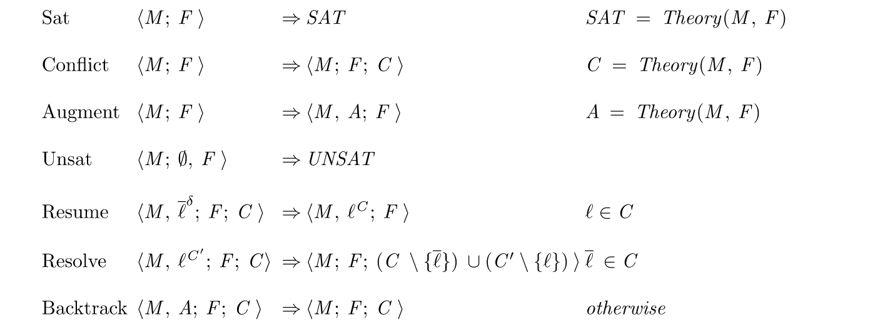
CDCL(T) as inference rules

Slide 23
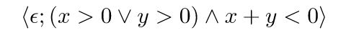
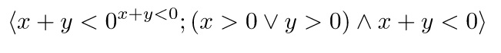
CDCL(T) as inference rules

Slide 24
CDCL(T) as inference rules

Slide 25
CDCL(T) as inference rules

Slide 26
CDCL(T) as inference rules

Slide 27
CDCL(T) as inference rules

Slide 28
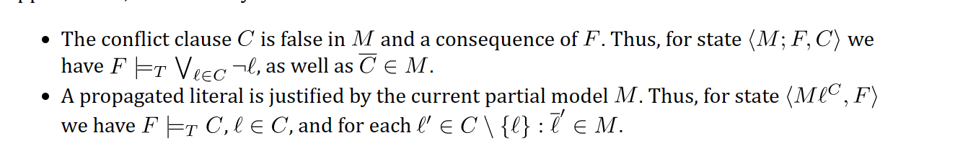
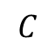
CDCL(T) - Invariants
M
F
$$C$$

Slide 29
CDCL(T) – Dual Model/Proof search
Backjump
Models
literal assignments
Proofs
Conflict Clauses
Conflict Resolution
Propagate

Slide 30
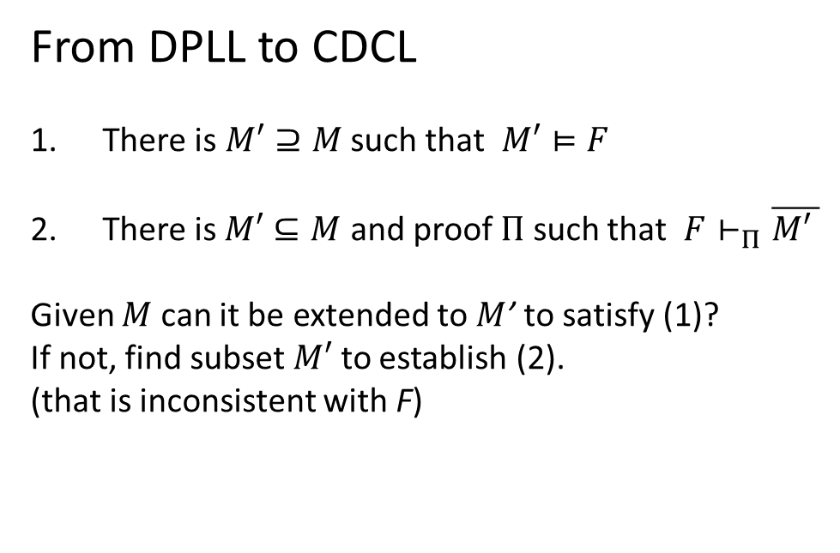
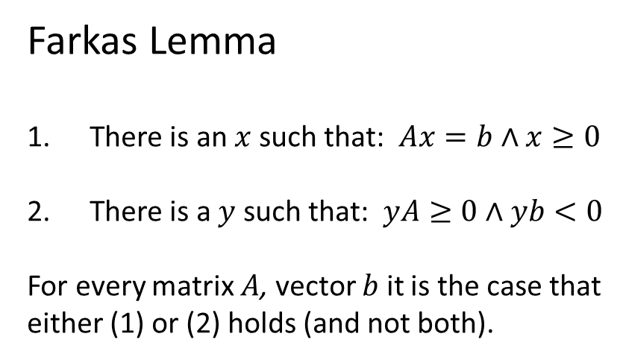
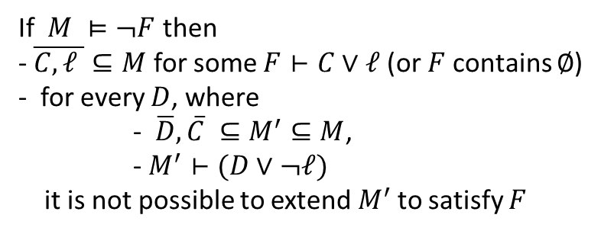
Dichotomy – Proofs and Models
Farkas Lemma
There is an $x$ such that: $Ax=b∧x≥0$
There is a $y$ such that: $yA≥0∧yb<0$
For every matrix $A$, vector $b$ it is the case that
either (1) or (2) holds (and not both).
From DPLL to CDCL
There is $M′⊇M$ such that $M′⊨F$
There is$M′⊆M$ and proof $Π$ such that $F⊢_{Π}\overline{M\text{′} }$
Given $M$ can it be extended to $M$’ to satisfy (1)?
If not, find subset $M′$ to establish (2).
(that is inconsistent with F)
Corollary
Conflict learning (resolution)
extends F by clauses that block shorter models
If $M ⊨¬F$ then
- $\overline{C,ℓ }⊆M$ for some $F⊢C∨ℓ$ (or $F$ contains $∅$)
- for every $D$, where
- $\overline{D},\overline{C} ⊆M^{′}⊆M$,
- $M^{′}⊢(D∨¬ℓ)$
it is not possible to extend${ M}^{′}$ to satisfy $F$

Slide 31
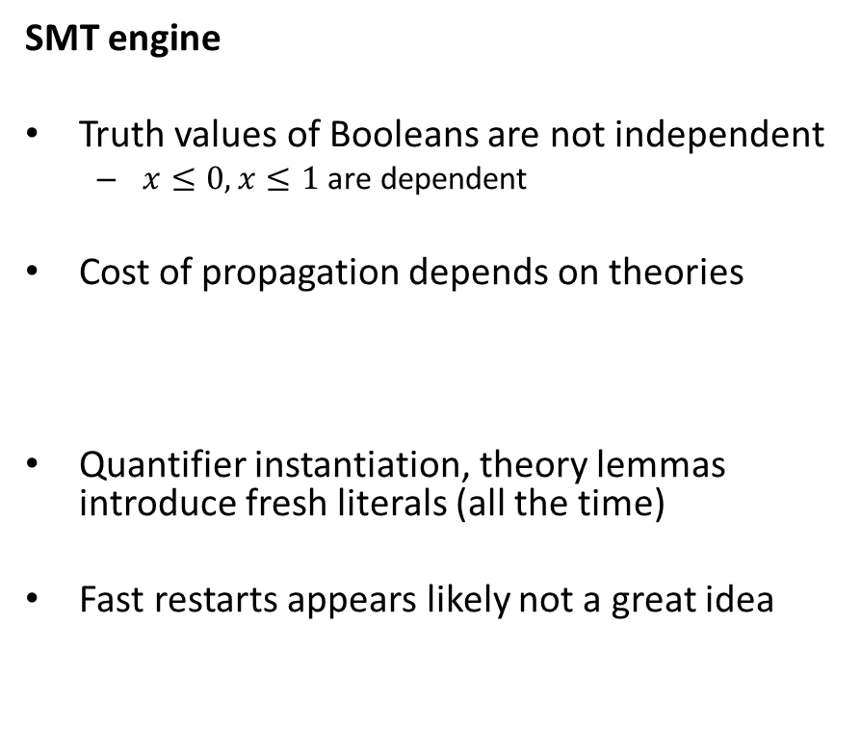
CDCL(T) – SAT vs SMT
SAT engine
Truth assignment is symmetric for Boolean variables
Probing (for failed literals)
L is failed if asserting L & F infers false by unit propagation.
Cost of propagation controlled by clause watch list
Boolean Variables are fixed during search
“Fast restart” introduced to prioritize variables used in conflicts
SMT engine
Truth values of Booleans are not independent
$x≤0, x≤1$ are dependent
Cost of propagation depends on theories
Quantifier instantiation, theory lemmas introduce fresh literals (all the time)
Fast restarts appears likely not a great idea

Slide 32
SPACER, NSLSAT, QSAT

Slide 33
Core Decision Procedures

Slide 34
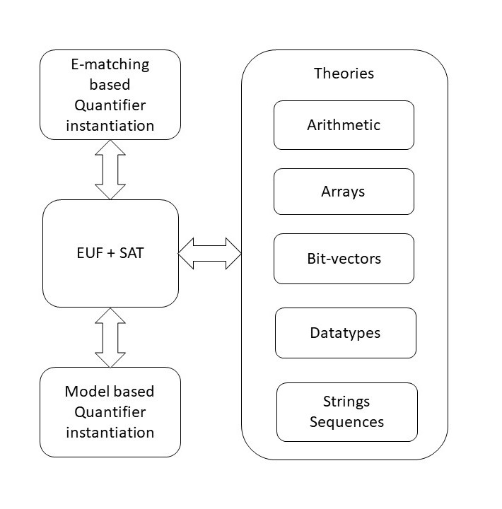
overview

Slide 35
Classification
Arrays
Finite Domains
ADTs
EUF
Arithmetic
Hybrid
str.len, bv2nat
User-Propagator

Slide 36
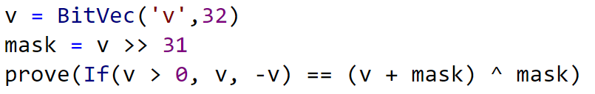
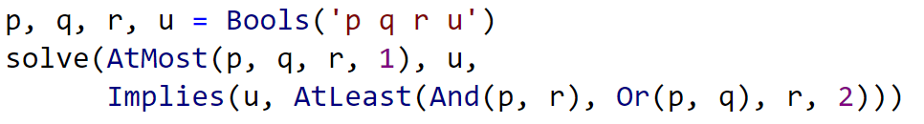
Finite Domain Theories

Slide 37
Finite Domains and CDCL(T)
Compile to SAT
Compile to SAT + E
PolySAT?

Slide 38
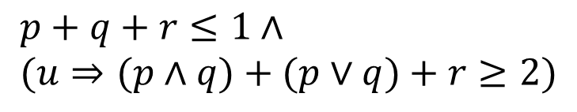
Finite Domains and CDCL(T)
$$p+q+r≤1∧ \\ (u⇒(p∧q)+(p∨q)+r≥2)$$
Compile to CDCL
Compile to CDCL + PB propagation

Slide 39
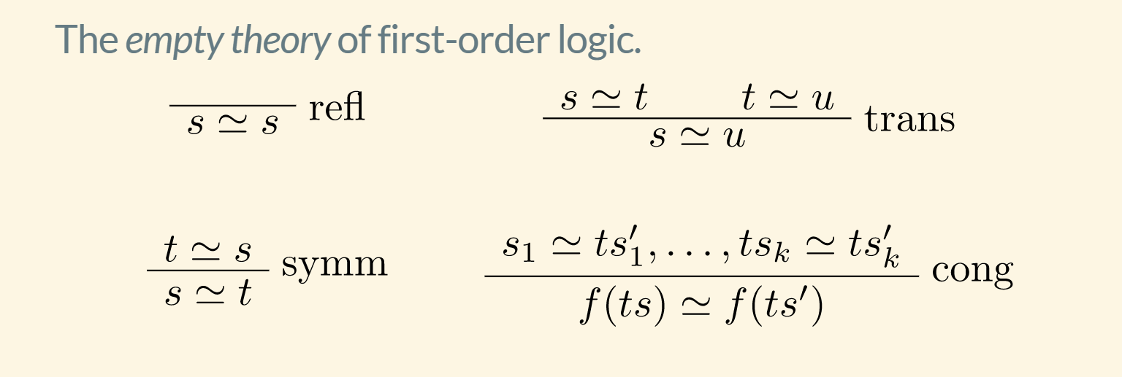
EUF

Slide 40
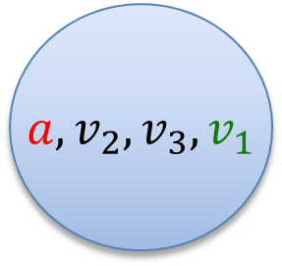
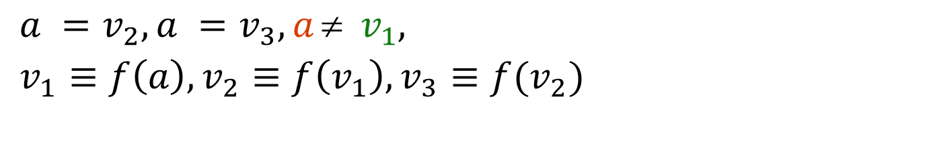
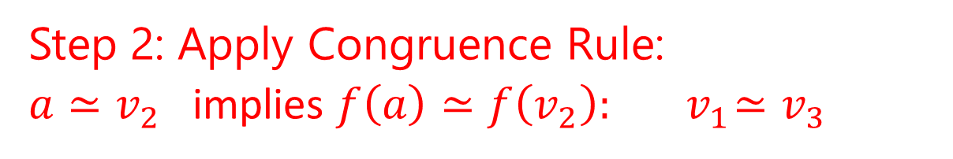
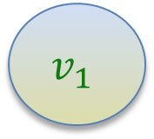
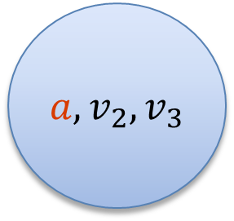
EUF
$$a = f(f(a)), a = f(f(f(a))), a  f(a)$$
Produce Proofs
Incremental Updates
Propagate Literals
$a =v_{2}, a =v_{3}, a  v_{1},$
$v_{1}≡f\left(a\right), v_{2}≡f\left(v_{1}\right), v_{3}≡f(v_{2})$
$a, v_{2}, v_{3}$
$$v_{1}$$
Union Find
Step 1: Equivalence classes from equalities
$a, v_{2}, v_{3}, v_{1}$
Step 2: Apply Congruence Rule:
$a≃v_{2}$ implies $f\left(a\right)≃f\left(v_{2}\right):{ v}_{1}≃v_{3}$
E-graph

Slide 41
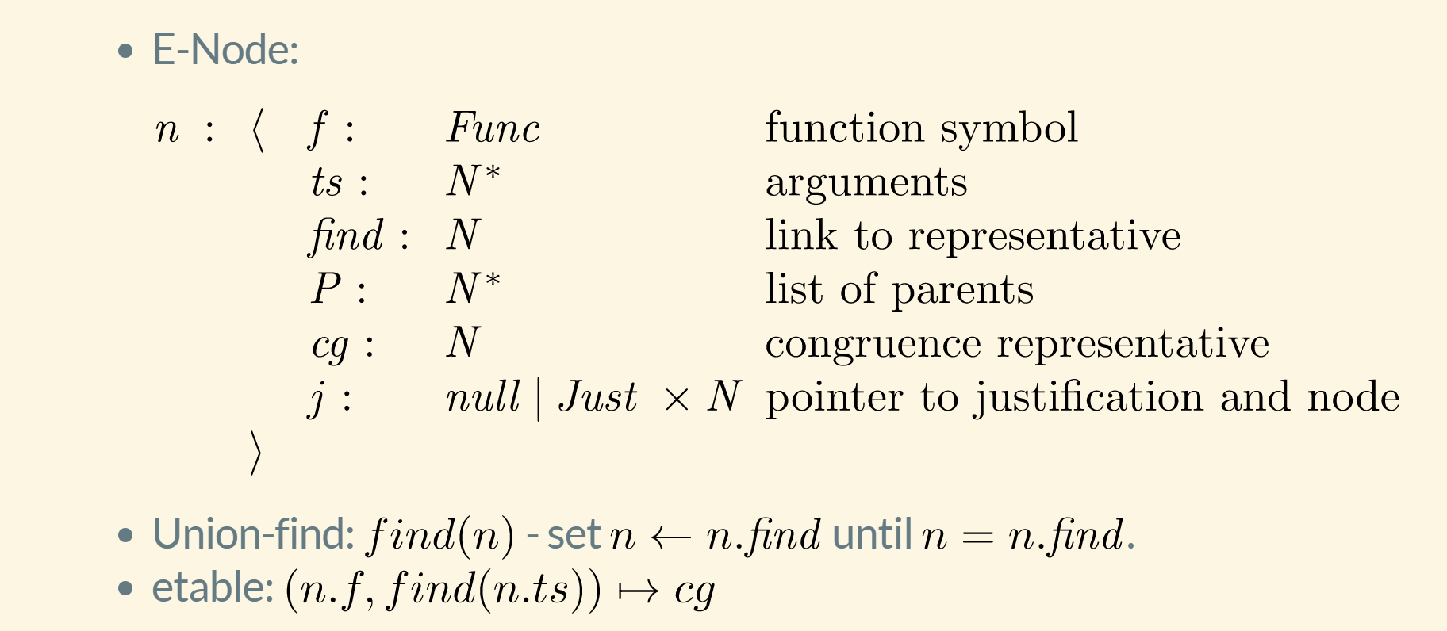
EUF – data-structure

Slide 42
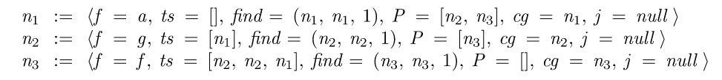
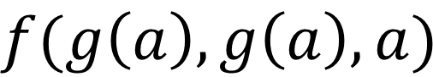
EUF - internalize
$$f(g\left(a\right), g\left(a\right), a)$$
Terms are “hash-consed”
Roots are initialized to self
etable: $[a↦n_{1},g\left(\left[n_{1}\right]\right)↦n_{2}, f\left(\left[n_{2},n_{2},n_{1}\right]\right)↦n_{3}]$

Slide 43
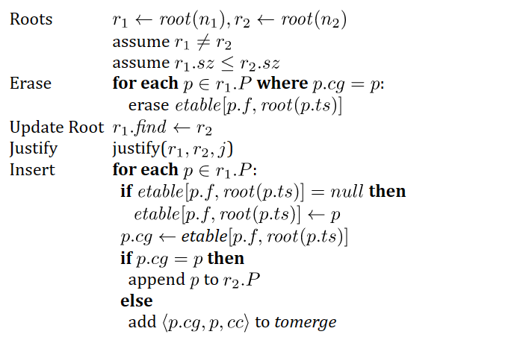
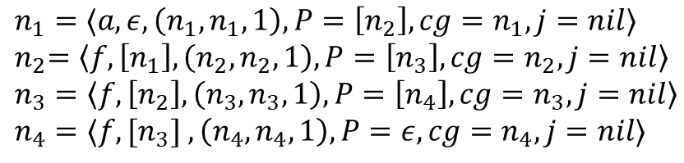

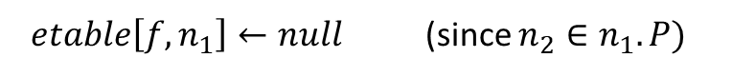
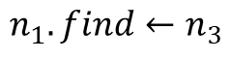
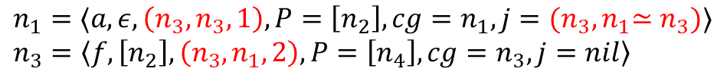
EUF - merge
$n_{1}=⟨a, ε, \left(n_{1},n_{1},1\right), P=\left[n_{2}\right], cg=n_{1},j=nil⟩$
${ n}_{2}=\left\langle f,\left[n_{1}\right], \left(n_{2},n_{2},1\right), P=\left[n_{3}\right], cg=n_{2},j=nil\right\rangle$
$n_{3}=\left\langle f,\left[n_{2}\right], \left(n_{3},n_{3},1\right), P=\left[n_{4}\right], cg=n_{3},j=nil\right\rangle$
$n_{4}=⟨f,[n_{3}] , \left(n_{4},n_{4},1\right), P=ε, cg=n_{4},j=nil⟩$
$${merge(n}_{1},n_{3})$$
$etable\left[f,n_{1}\right]←null$ (since $n_{2}∈n_{1}.P)$
$$n_{1}.find←n_{3}$$
$n_{1}=⟨a, ε, \left(n_{3},n_{3},1\right), P=\left[n_{2}\right], cg=n_{1},j={(n_{3},n}_{1}≃n_{3})⟩$
$n_{3}=\left\langle f,\left[n_{2}\right], \left(n_{3},n_{1},2\right), P=\left[n_{4}\right], cg=n_{3},j=nil\right\rangle$
($n_{2}∈n_{1}.P)$
$n_{2}.cg←etable[f, {root(n}_{1})]=$ $n_{4}$
$add \left\langle n_{2},n_{4}\right\rangle$ to tomerge

Slide 44
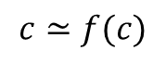
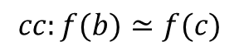
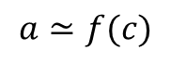
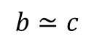
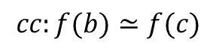
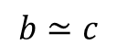
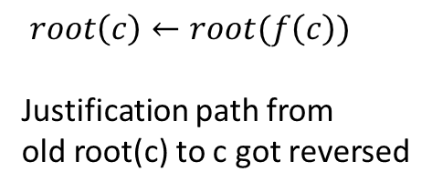
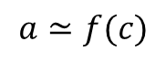
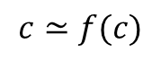
EUF - Justifications
a
b
Union – find link
$$a≃f(c)$$
$$b≃c$$
Justification link
f(b)
f(c)
c
$$cc:f(b)≃f(c)$$
a
After merge
$$c≃f(c)$$
$$a≃f(c)$$
b
$root\left(c\right)←root(f\left(c\right))$
Justification path from
old root(c) to c got reversed
$$b≃c$$
f(b)
f(c)
$$cc:f(b)≃f(c)$$
c
$$c≃f(c)$$

Slide 45

EUF - internals
Nodes from Boolean literals contain fields:
value : { true, false, undef}
boolVar : a number referring to Boolean variable as known by SAT solver
Equality nodes are special: When n1, n2 are merged, the parent n5 is equality, value = false -> conflict
$$a  f(a)$$
$n_{5}=⟨≃, [n_{1},n_{2}], \left(n_{5},n_{5},1\right), P=ε, cg=n_{5},j=nil, value=false, boolVar=27⟩$

Slide 46
EUF – internals: equalities and values
Values: If a node comes from a term that denotes a value (5, 42, 2/3, cons(1,nil)), it is always a root
When two roots with terms based on different values are merged -> conflict
Who reasons about equalities of Booleans? EUF vs. CDCL
E-nodes based on Bool do by default not merge with other nodes.
Default is overridden if E-node occurs under a non-connective.
E-graph propagates equalities to theories and Booleans to SAT
$n_{5}=\left\langle ≃, \left[n_{1},n_{2}\right], \left(n_{5},n_{5},1\right), P=ε, cg=n_{5},j=nil, value=undef, boolVar=27\right\rangle$
$n_{1}.find←n_{2}$ -> value is set to true and assignment to boolVar 27 is propagated to CDCL core

Slide 47
Arithmetic
SAT/SMT Backtracking
Search
Propagation
+ Conflicts
Assert bounds on integer/real variables
Solve for Reals Use Simplex to find solutions to constraints + bounds
Bounds propagation Infer equalities and bounds from existing bounds
Solve for Integers
Cube
GCD test
Branch and Bound
Hermite Normalize
Gomory Cuts
Solve for multiplications
Bounds propagation
Horner expansion
Gröbner solving
Incremental linearization
NL-SAT
SAT

Slide 48
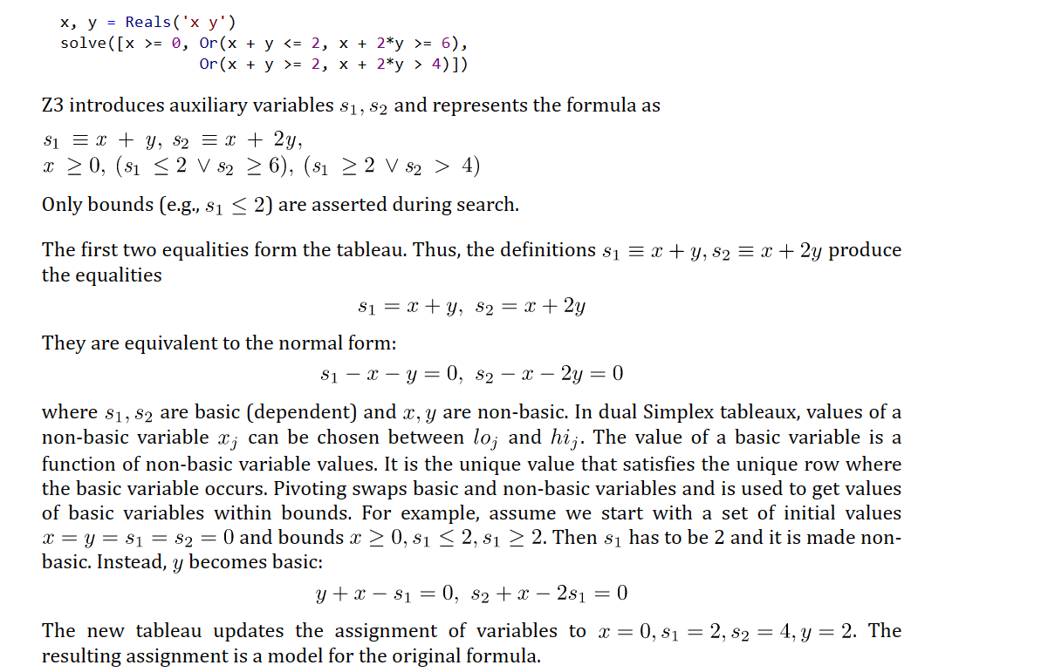
Arithmetic - LP
Placeholder

Slide 49
Arithmetic - LP

Slide 50
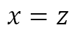
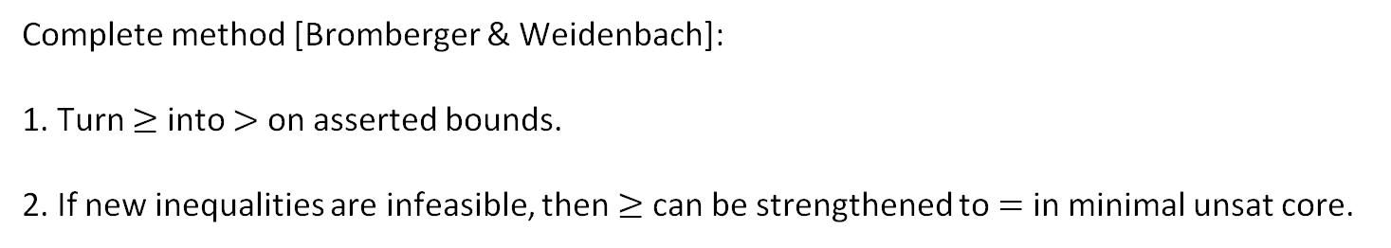
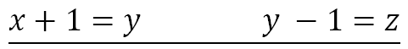
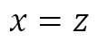
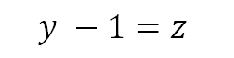
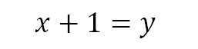
Propagating Equalities
SAT/SMT Backtracking
Search
$$x=z$$
$$x+1=y$$
Assert bounds on integer/real variables
$$y −1=z$$
Complete method [Bromberger & Weidenbach]:
1. Turn $≥$ into $>$ on asserted bounds.
2. If new inequalities are infeasible, then $≥$ can be strengthened to $=$ in minimal unsat core.
Bounds propagation Infer equalities and bounds from existing bounds
$$\underline{x+1=y y −1=z}$$
$$x=z$$

Slide 51
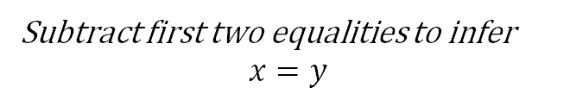
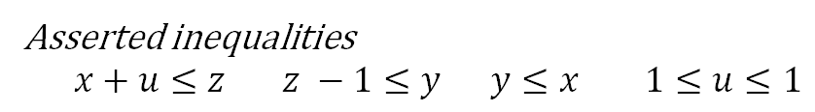

Propagating Equalities
Equality inferences require addition/subtraction operations
Asserted inequalities
$x+u≤z z −1≤y y≤x 1≤u≤1$
$$\underline{x+1=y y −1=z}$$
$$x=z$$
How the solver sees the constraints
$x+u+s_{1}=z z −1+s_{2}=y y+s_{3}=x 1≤u≤1 0≤s_{1} 0≤s_{2} 0≤s_{3}$
After pivoting
$$x=z−u −s_{1} y=z −1+s_{2} s_{3}={−s}_{2}− {u+1− s}_{1} 1≤u≤1 0≤s_{1} 0≤s_{2} 0≤s_{3}$$
After propagating bounds on $s_{1}, s_{2},s_{3}$
$$x=z−u −s_{1} y=z −1+s_{2} s_{3}={−s}_{2}− {u+1− s}_{1} 1≤u≤1 0≤s_{1}≤0 0≤s_{2}≤0 0≤s_{3}≤0$$
Subtract first two equalities to infer
$$x=y$$
Subtle complexity: Every row can have many fixed variables. Adding values of constant bounds requires significant runtime.

Slide 52




Propagating Equalities - efficiently
$$\underline{x=z−u −s_{1} y=z −1+s_{2} 1≤u≤1 0≤s_{1}≤0 0≤s_{2}≤0 0≤s_{3}≤0}$$
$$x=y$$
Instead of adding up rows to prove implied equality
Use fact all variables have values assigned by Simplex solver
Then two variables are equal if
They are connected through offset equalities
They have the same value
offset equality
$$x=y+{\underset{{b_{1}≤z}_{1}≤b_{1}, { b}_{2}≤z_{2}≤b_{2},}{\underbrace{{a_{1}z}_{1}+a_{2}z_{2}+…}}}_{}$$
Example: If solver assigns $x=3$ then $z=4, y=3$
$x, y$ are connected (over $z−1$).
$x, y$ have the same value (3)

Slide 53
Arithmetic – Integers
Cube
GCD
(picture of a polyhedron)
(twist for difference/octagon)
(example GCD)
Branch and bound
Cut
(a note about cut strength)
(a note about SAT problems)

Slide 54
Arithmetic – Integers
In scope
Bounds propagation to CDCL
Equality propagation to T
Modeling at level of SMT
Out of scope
Finite domains
Weak cuts
Incomplete for mixed-Integer
Modular arithmetic and LP

Slide 55



Arithmetic – Non-linear
Non-linear bounds
Gröbner
Factoring and equality propagation
$$xy=0∧xyz+u−v=0⇒u=v$$
Solving (based on variable ordering)
$$x+p=0∧x^{2}q+r=0⇒p^{2}q+r=0$$
Result of GB used for bounds propagation
(Interval propagation)
(representation strength)
Polynomials as
Multi-terminal ZDDs
Incremental Linearization
NLSAT
(tangent and other lemmas)
(how it is staged?)

Slide 56
Arithmetic – Non-linear
In scope
Bounds and Equality propagation
Polynomials over reals (low degree)
Out of scope
Polynomials over integers
Exponentiation
Trigonometric functions
Indefinite operations
summations/products/integrals

Slide 57
Data-types, Arrays

Slide 58


Custom Theories

Slide 59
Data-structure Internals

Slide 60


Terms and Formulas
de Bruijn index
Terms are hash-consed
let t = App(f,args) let t’ = termTable[t] mkApp(f, args) = if t’ = nil then termTable[t]$←t$; t else t’

Slide 61

Assertion Internals

Slide 62
Compiling Assertions To Search State

Slide 63
Core <-> Solver interface

Slide 64
Model-based Theory Combination

Slide 65
Relevancy Filtering

Slide 66
Ackermann reductions

Slide 67
Iterative Deepening

Slide 68
Interfacing with Z3
A Quiz and some Answers

Slide 69
Efficiency
Scale
Technology Landscape
Propositional
Satisfiability Solving
SAT
Breakthroughs in 2000s
Cheap local Inferences
Garbage collect useless clauses
Hardware Design
Automation
Breakthroughs late 2000s
SAT + global inferences +
global propagators
Mixed Integer
Programming
MIP
Breakthroughs in 1960s
Harnessed since 1990s
LP: global Inferences
IP: Cuts, Branch and Bound
Satisfiability Modulo Theories
Operations
Research
CP-SAT
SMT
Z3
Constraint
Programming
Software Development +…
CP
Breakthroughs since 1990s
Powerful domain-tailored
global propagators
Expressive Power

Slide 70
Satisfiability Modulo Theories (SMT)
Is formula ϕ satisfiable modulo theory T ?
SMT solvers have specialized algorithms for T

Slide 71
Formulating Formulas for Z3
Capturing Finite domains as propositional theories
SAT
BV = SAT or SAT + equality propagation
PB = SAT + cardinality + weighted Boolean inequalities
Symmetries
Programming With Quantifiers

Slide 72
Controlling Search
SAT engine control
Variable phases
Sat.threads, parallel.enable
Lookahead Solving
Ackermann reduction
Arithmetic and finite domains

Slide 73
Retrieving Information
Model, Core, Proof
Clausal Proof Logs, Trace
API Log, SMT log, Lemma log

Slide 74
Tactics

Slide 75
Example tactic
What is a tactic
Properties of tactics
Use case of Alive2

Slide 76
Online reference to tactics
Classification of tactics
Incremental tactics

Slide 77
Models

Slide 78
Model Formats

Slide 79
Extracting Models

Slide 80
Certificates

Slide 81
Certificate Formats

Slide 82
Using Certificates

Slide 83
Quantifiers

Slide 84
E-matching

Slide 85
MBQI

Slide 86
MBP

Slide 87
SAT + Theory Solvers A basis for SMT

Slide 88
A Universe of Theories and Solvers

Slide 89
A universe of theories
Boolean | finite domains
Base | arithmetic and uninterpreted functions
Reducible | reduce to base theories
Hybrid | non-disjoint combinations
External | propagation rules

Slide 90


A universe of theories
Base | arithmetic and uninterpreted functions (EUF)

Slide 91


A universe of theories
Reducible | reduce to base theories
Compile into EUF
UNSAT

Slide 92


A universe of theories
Reducible | reduce to base theories
Convert EUF solution to
solution over arrays
Compile into EUF

Slide 93


A universe of theories
Hybrid | non-disjoint combinations
$$\frac{s=\text{"}\text{abcd}\text{" }u=\text{"}\text{def}\text{"} |t|=\text{7}}{t="\text{abcddef}"}$$

Slide 94


A universe of theories
External | propagation rules
When encodings into existing theories is too expensive
$$1000≥\sum_{0≤i<j≤500}{x_{i}+x_{j}=42∧\left(x_{i}>30∨x_{j}>30\right)}$$
As code:
Introduces one callback + conflicts on demand
As constraints:
Introduces 100Ks
atomic formulas

Slide 95
The usual z3 intro slides

Slide 96




Logic: The Calculus of Computation
Invariants
Differential, Integral Calculus
Logic
Dynamics, Conduction,..
Matlab, Mathemetica, Simulink
Computation
Claim: Practically all modern program analysis tools involve solving logical formulas

Slide 97















for Software +…
Azure Network
Verification
Verifying C
Compiler
Quantum
Compilation
Biological
Computations
Verified Crypto
Libraries & Protocols
Dynamics
AX
SVACE
Static Analysis Engines
Artificial
Life
Security Risk Detection
Smart Contract
Verification
ALIVE2
Translation Validation
for LLVM & Visual C++
Axiomatic
Economics
Assembly Line
Optimization

